Slide 1
Mustang Hours
Sprint 1 Review
Sep 23, 2026 · Cal Poly SE Capstone · Sponsor: Dr. John Clements
Members: Ryan Tran, Owen Sam, Aaron Lee, Arjan Ellingson

Slide 2
Project Vision
For Cal Poly students, instructors, and department staff who need to share and find office hours, Mustang Hours is a small, open-source office-hours directory that puts every instructor’s hours, office, and format (in person or Zoom) in one place. Unlike today’s department pages, where every department posts hours differently, it keeps the data consistent and asks as little of instructors as possible.
1
Input
2
Manage
3
Output
How instructors supply hours
How department staff fix and update
How students find hours
Scraper today; Microsoft Form, calendar, or time picker under study
Edit, correct, add, remove entries
Searchable web page on GitHub Pages; calendar (.ics) export next

Slide 3
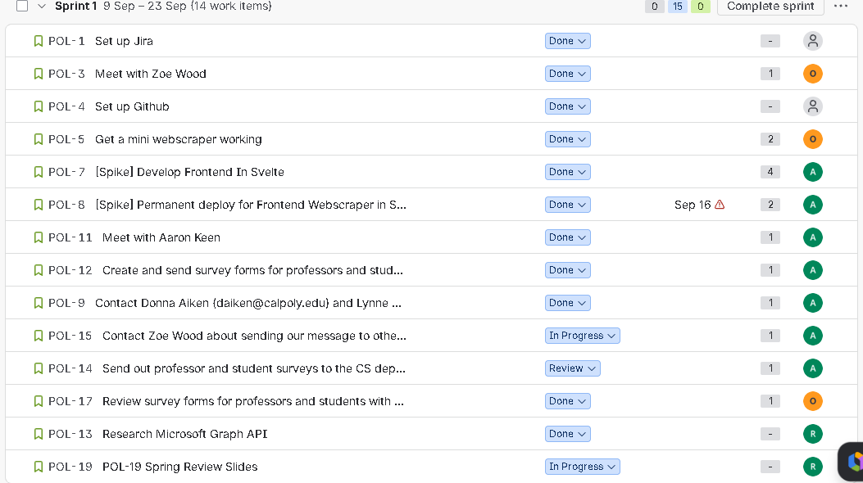
Sprint 1 Backlog
14 work items · 15 story points estimated
Key | Item | Status | Pts
POL-1 | Set up Jira | Done | –
POL-3 | Meet with Zoe Wood | Done | 1
POL-4 | Set up GitHub | Done | –
POL-5 | Get a mini web scraper working | Done | 2
POL-7 | [Spike] Develop frontend in Svelte | Done | 4
POL-8 | [Spike] Permanent deploy for frontend | Done | 2
POL-11 | Meet with Aaron Keen | Done | 1
POL-12 | Create survey forms for professors and students | Done | 1
POL-9 | Contact Donna Aiken and Lynne (CPE) | Done | 1
POL-17 | Review survey forms with Clements | Done | 1
POL-13 | Research Microsoft Graph API | Done | –
POL-15 | Ask Zoe Wood to share with other departments | In Progress | 1
POL-14 | Send surveys to the CS department | Review | 1
POL-19 | Sprint review slides | In Progress | –
11 / 14
items done
3
carry over to Sprint 2
(POL-14, 15, 19)

Slide 4
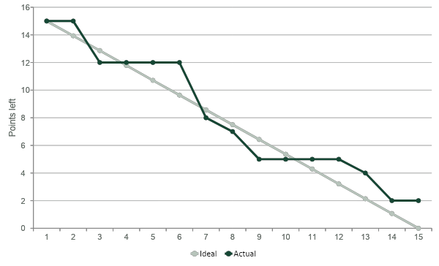
Sprint 1 Burndown
Story points remaining, Sep 9 – Sep 23
13 / 15
points completed
2
points left (plus unpointed POL-19)
Flat 9/11–9/14 and 9/17–9/20
Work was conducted, but late. Communication halted over weekend periods

Slide 5
Sprint Strengths & Weaknesses
+
Strengths
–
Weaknesses
Talked to stakeholders early: Zoe Wood, Aaron Keen, and the CPE office, with Clements added to Slack
Working scraper for CSSE and English, with a normalized CSV
Svelte prototype live on GitHub Pages with CI/CD
Student and faculty surveys built, reviewed, and approved
Found the real problem: every department formats hours differently
Jira updated after the fact (as items are not backlogged at start of project), so the board lagged behind real work
Some tickets never estimated (POL-13, POL-19)
POL-8 deploy slipped past its Sep 16 due date
Built frontend before survey results told us what users want

Slide 6
Retrospective
Keep doing
Stop doing
Start doing
Meeting stakeholders early and often
Reviewing each other’s drafts in Slack before sending
Short spikes to prove ideas fast
Logging tickets after work is done
Leaving tickets without points
Building features before we know they’re wanted
Create a Jira ticket before starting any task
Post meeting notes in Slack the same day
Split points so the burndown moves daily
Formalized Sprint [X] Goal Posted in Jira
Action item for Sprint 2: every task gets a pointed Jira ticket at planning, and the board is updated before each standup.

Slide 7
Next Sprint Tasks
Continue meeting with stakeholders
Focus on other CENG departments (CSSE and CPE already done)
Try to get buy in from them so we can became a more integrated part of this process
Adapt web scraper to web scrape every CENG department
Tooling for professors to find optimal times to hold office hours
Automatic updates from forms -> website
Work on more features to showcase to stakeholders

